Slide 1
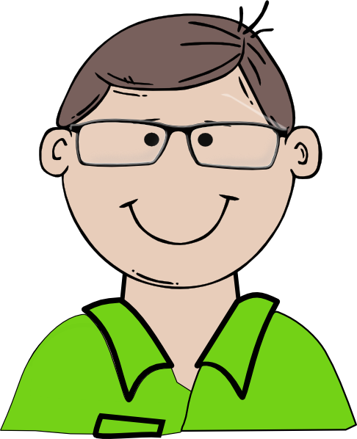
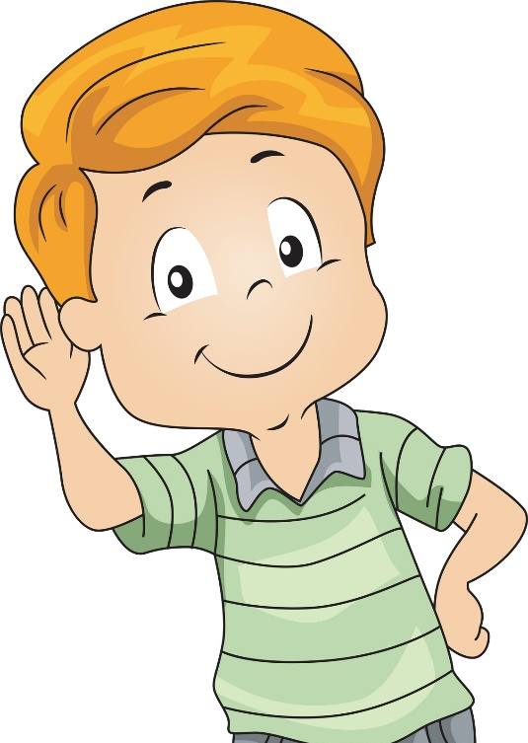
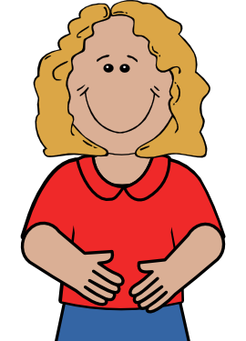
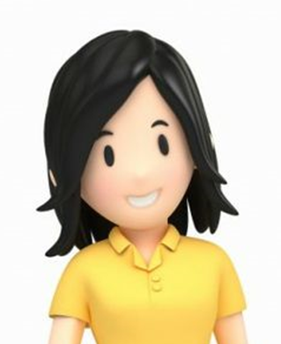
dad, Peter, dark,
brown, kind, dentist
son, Sam, fair,
grey, funny, pupil
mum, Helen, blond,
brown, nice, cook
aunt, Ann, dark,
brown, clever, writer

Slide 2
cousin, Molly, dark,
brown, good, pupil
granny, Meg, grey,
blue, kind, farmer
grandad, Bob, white,
blue, old, farmer
uncle, George, red,
green, lazy, farmer
https://vk.com/redcatnotes
https://vk.com/redcatnotes

Slide 3
uncle, Ben, brown,
brown, funny, cook
cousin, Andy, dark,
clever, businessman
aunt, Rosie, dark,
green, beautiful
daughter, Sally, dark,
brown, little, naughty

Slide 4
aunt, Alice, blond,
blue, nice, singer
son, Tim, dark,
brown, kind, pupil
uncle, Mark, dark,
grey, funny, worker
daughter, Liz, dark,
brown, nice, little

